Slide 1
Error 404: Job Loss
Amber Yeasin
Sam lopez
Jaspreet kaur
EECS 448 Project 2

Slide 2
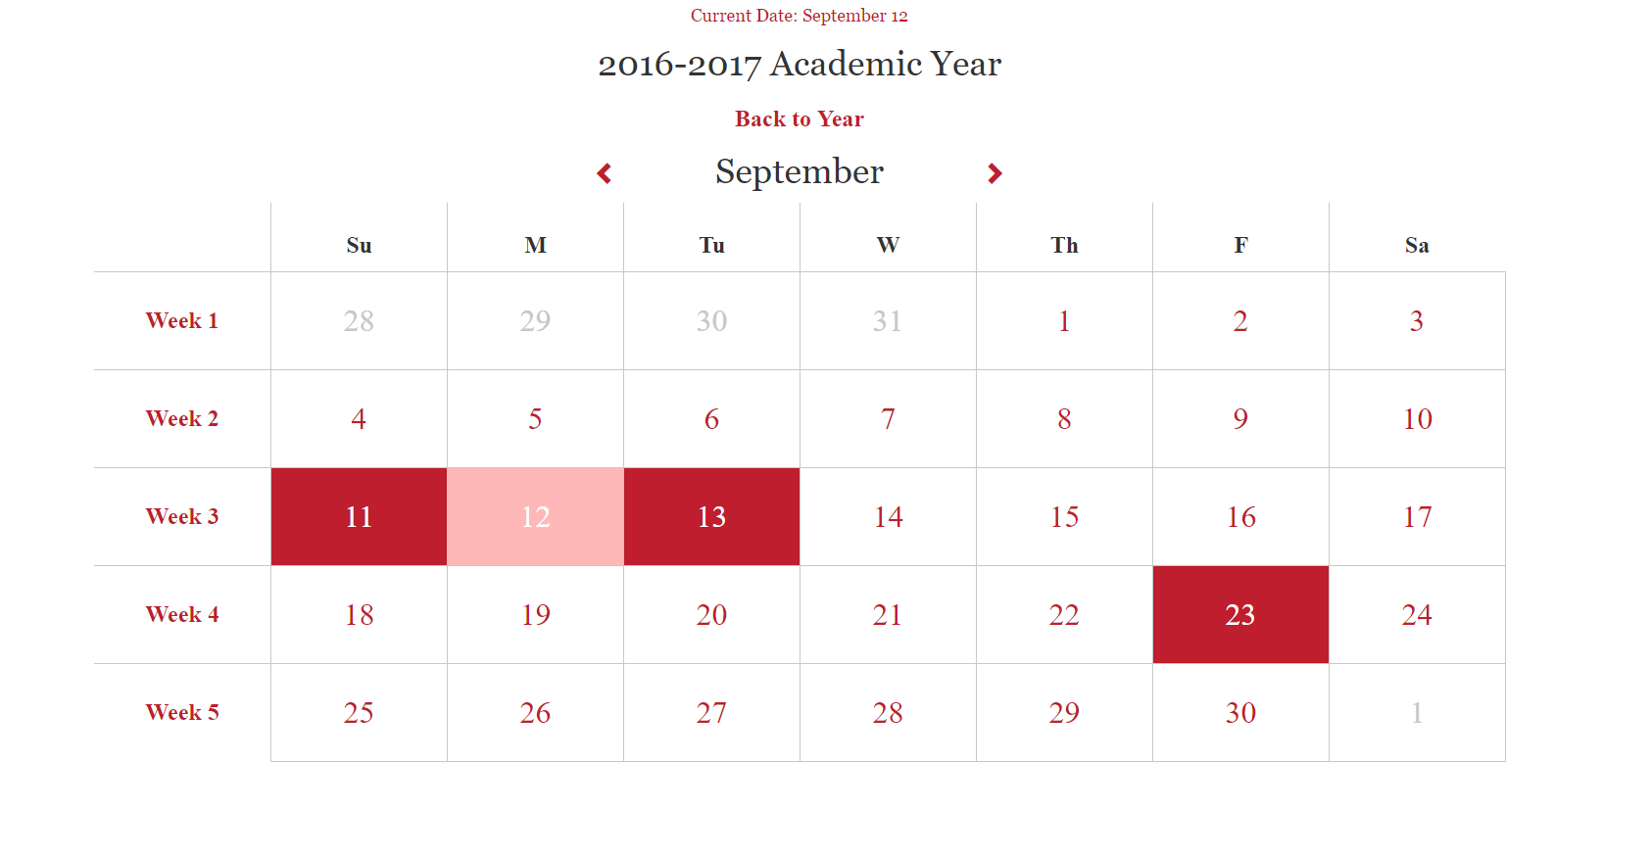
Overview
Web Platform
Front End:
HTML
CSS
Typescript
powered by Angular 2
Back End:
Perl

Slide 3
Division of Labor
Amber
Front end implementations
Multi Day Events
Repeating Events
UML Diagrams
Presentation
Jaspreet
Repeating event template
UML Diagrams
Presentation
Sam
Back end implementations
Timing attribute
Organizing by time
Setting up and hosting code environment
UML Diagrams

Slide 4
Challenges
Scheduling conflicts
Learning Perl and typescript
Setting up Angular 2
Running code base locally and globally
Merging code

Slide 5
Excluded Functionalities
Dropdown menu for type of event
CSS for choosing time and dates for events
Formatting for time
Time organization updated immediately without refresh

Slide 6
Retrospective
Familiarization with new languages should have started sooner
Should have allotted more time to setting up code environment
Significantly delayed progress
Better division of labor
More frequent commits and merges
Set and meet more benchmark goals to stay on track

